Slide 1

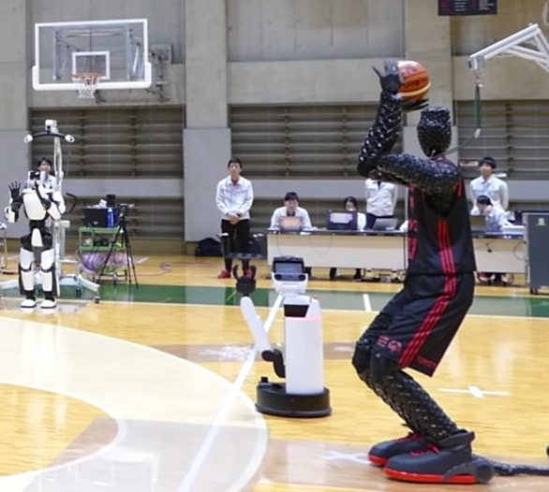


Project title & description
NBA player robot replacer
Using Automated Machine Learning to Predict NBA Player replacement

Slide 2
TEAM MEMBERS:
Gregory Gibbs | gregorysmithgibbs@gmail.com
Juan Ulloa | ulloajuan@hotmail.com
Adam Burstyn | adam.burstyn@gmail.com
Ignacio Domaica | idomaica@gmail.com

Slide 3
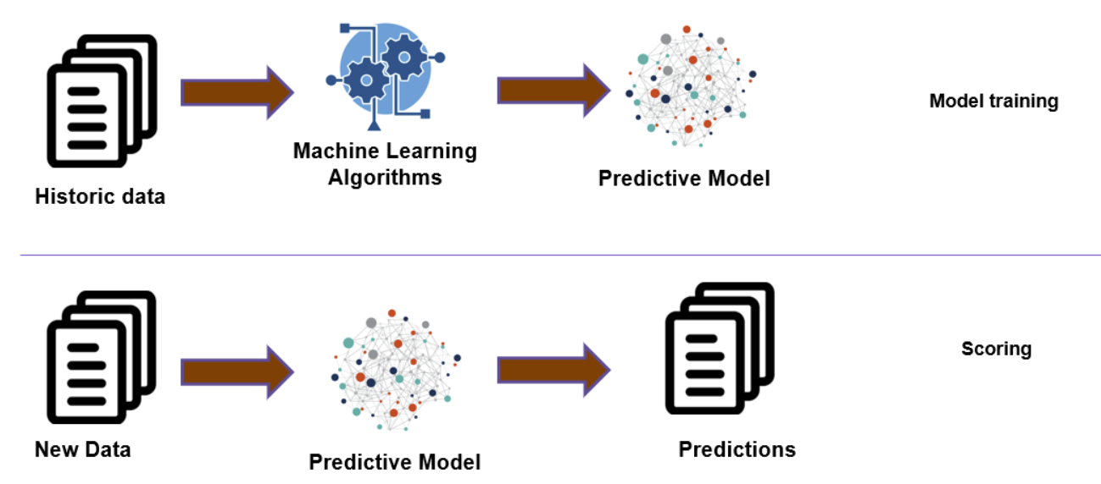
Scope
The idea would be to determine which player is best suited to fill a certain position on any NBA team based on existing players and-or including draftees or not.

Slide 4
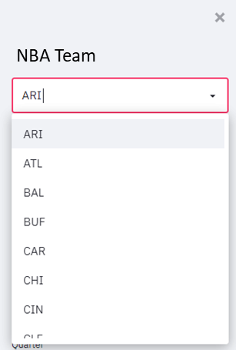
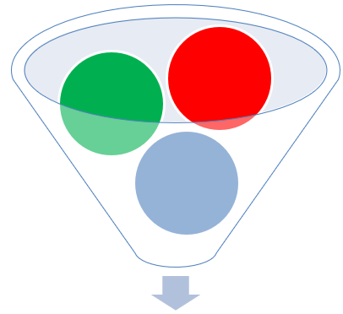
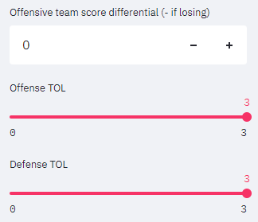

Design / Steps
STEP 1.- Select specific team
Select specific player
STEP 2.- Selected player will have specific performance reflected in stats.
Specific performance data can be loaded as defaults to make corrections using additional tools, like sliders, filters, etc?
DATA.- Will be collected from:
Kaggle
NBA stats
NCAA stats (eventually)
We will use last 2 seasons averages

Slide 5
Design / Steps (2)
PLAYER PERFORMANCE METRICS
There are many ways to assess player performance. At the most basic level, basketball is about scoring more points than the opponent, so naturally points-per-game is a nice place to start.
But, there are other methods to quantify player performance, and some of them get quite complex like Box Plus Minus or Player Efficiency Rating.
For this exercise , we will use a very accepted measurement called Game Score which helps predict player performance.
The formula for Game Score is as follows:
game_score = PTS + 0.4 * FG – 0.7 * FGA – 0.4*(FTA – FT) + 0.7 * ORB + 0.3 * DRB + STL + 0.7 * AST + 0.7 * BLK – 0.4 * PF – TOV.
Game Score (game_score) attempts to incorporate some of the most important individual statistics and weights them to maximize its correlation with winning. Game Score was created by John Hollinger to give a rough measure of a player’s productivity for a single game.
Glossary
SALARY
Specific players have contracts and salaries. Do we want to filter players also with salary data to respect salary caps?

Slide 7
Design / Steps (3)
STEP 3.- Apply models and machine learning to make proper forecasting / predictions
Will make 3 recommendations:
Closest player
Closest player including salary
Drafted player?

Slide 8
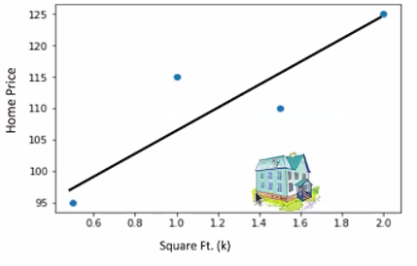
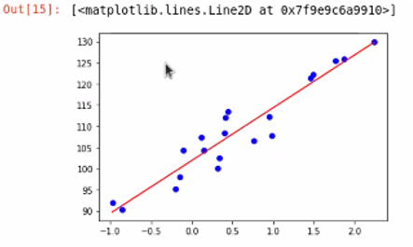
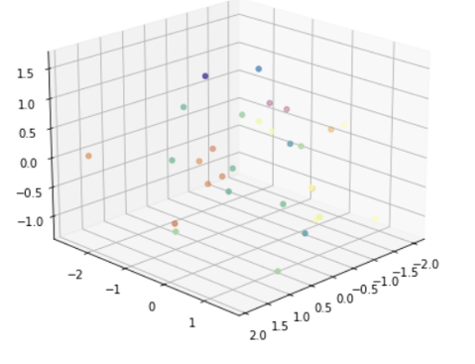
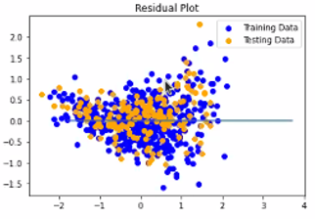
MODELS
Linear Regression / Sklearn
Multiple Linear Regression Sklearn
Dummy encoding? Lasso
Ridge
ElasticNet

Slide 9
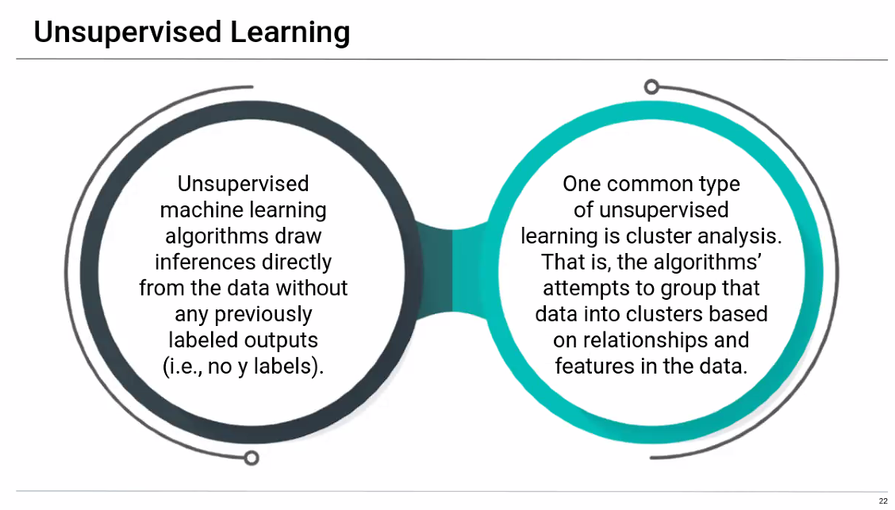
MODELS
Neural network – Keras?
Unsupervised learning

Slide 10
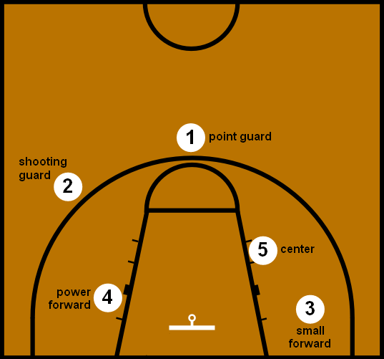
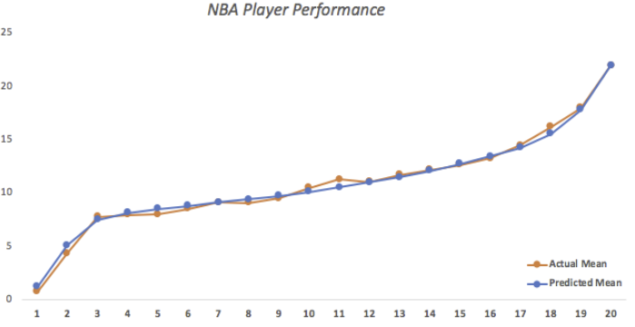
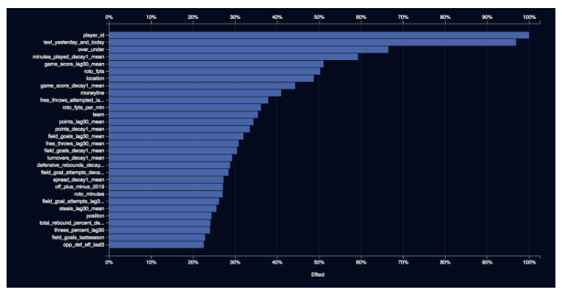
VISUALIZATIONS
To be determined:
Tableau: worksheets, story, dashboard?
Maxplotlib
Model comparisons?
Feature impact?

Slide 11
BACK UP
11

Slide 12
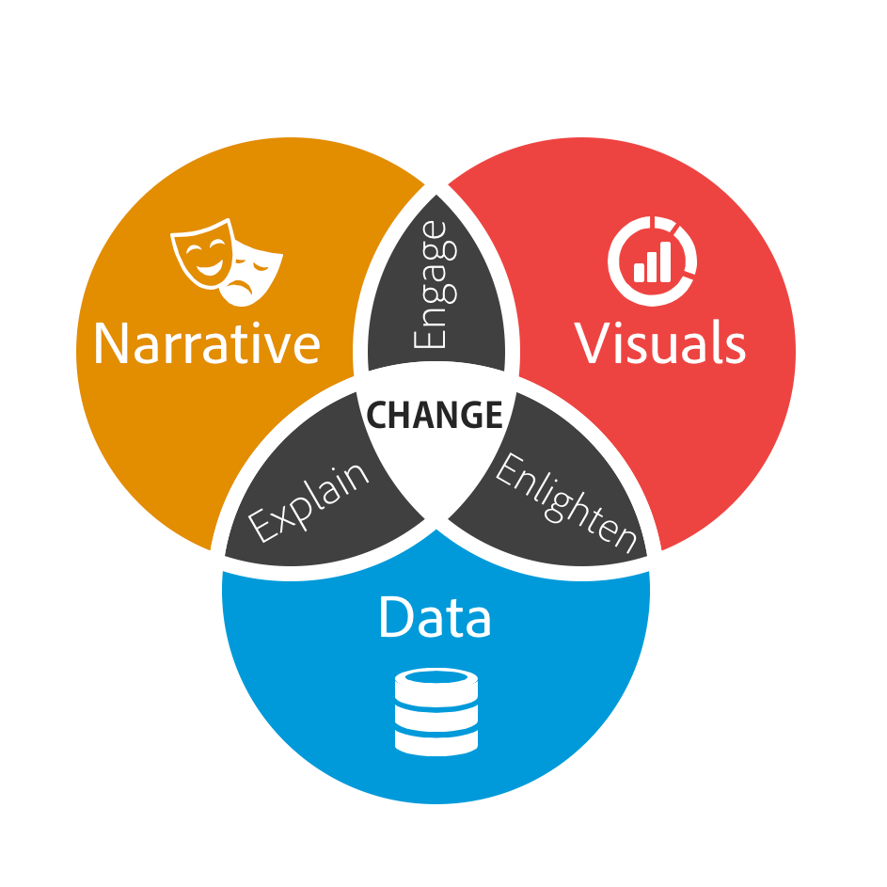

Slide 13
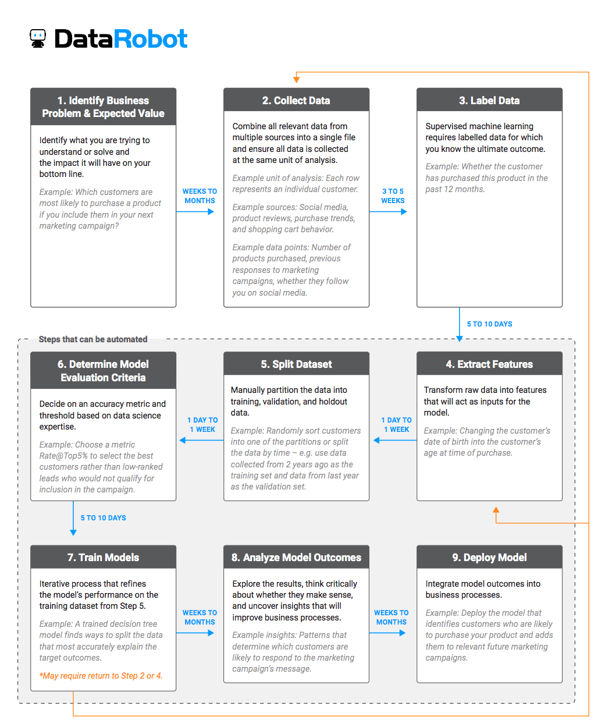

Slide 14
We can also perform the same calculation using the euclidean() function from SciPy. The complete example is listed below.
Running the example, we can see we get the same result, confirming our manual implementation.
1 2 3 4 5 6 7 8 | # calculating euclidean distance between vectors from scipy.spatial.distance import euclidean # define data row1 = [10, 20, 15, 10, 5] row2 = [12, 24, 18, 8, 7] # calculate distance dist = euclidean(row1, row2) print(dist)

Slide 15
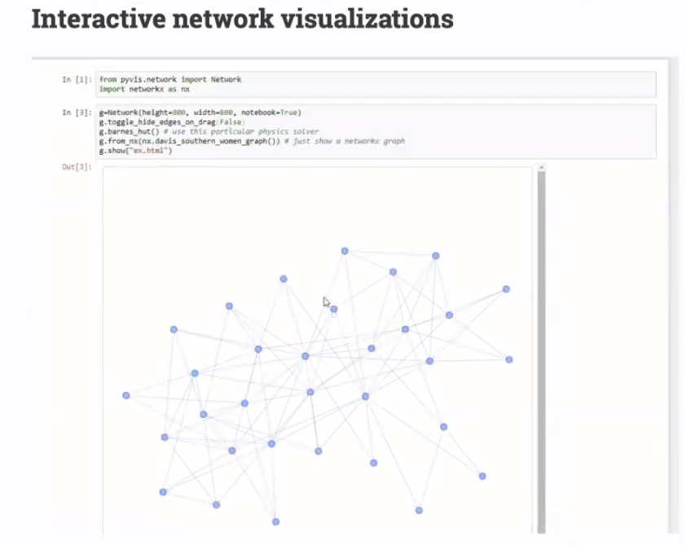
Pyvis

Slide 16


Slide 17
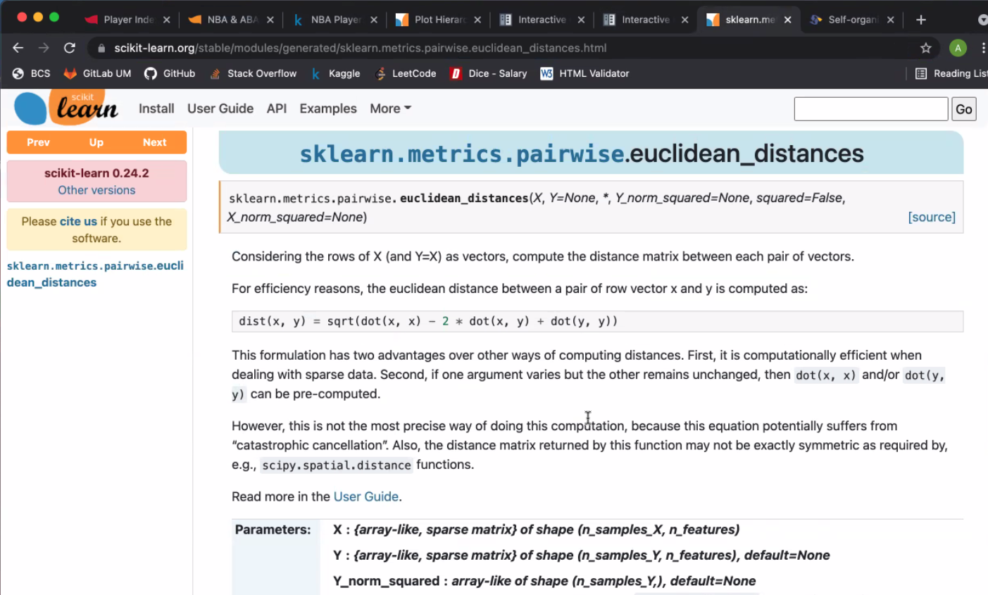

Slide 18
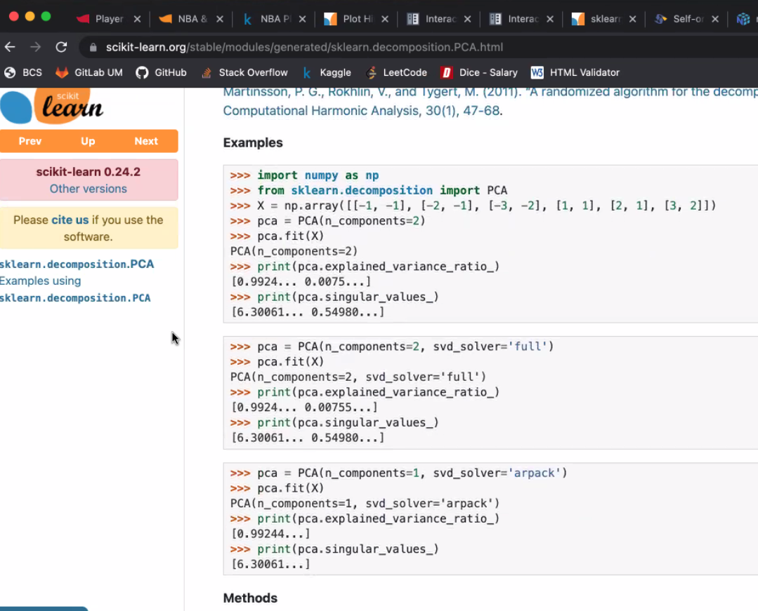

Slide 19
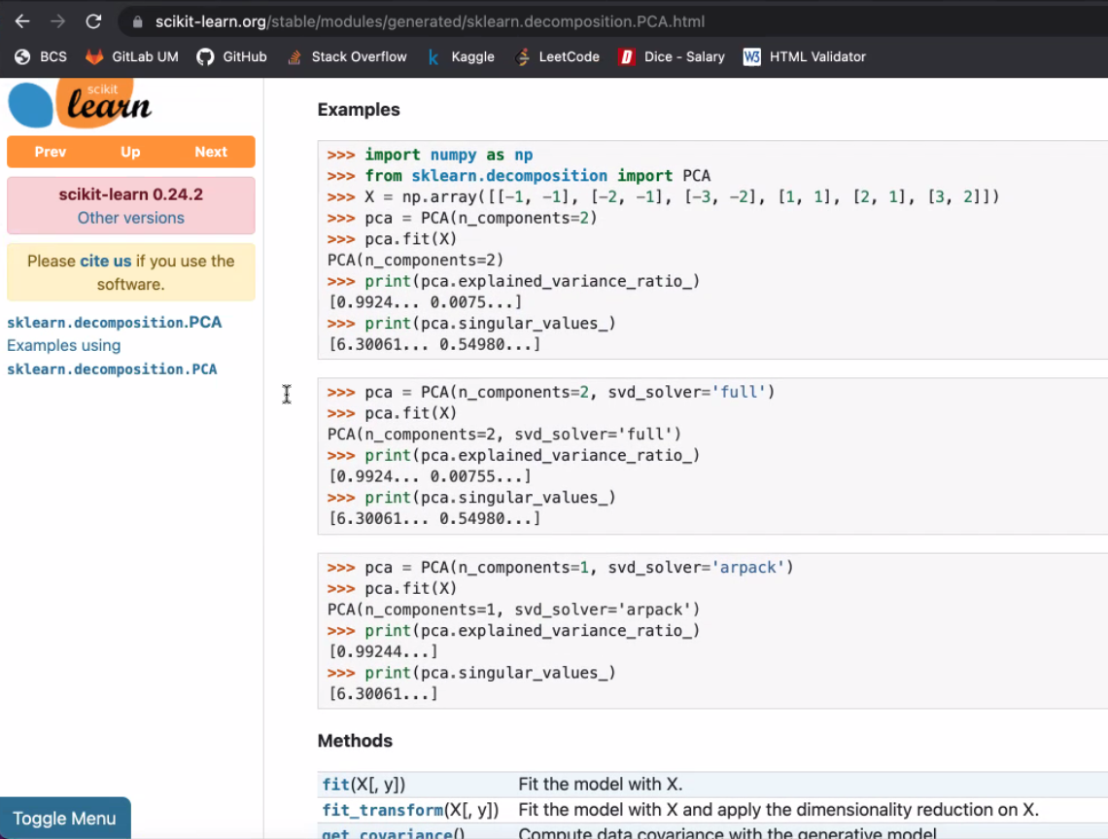

Slide 20
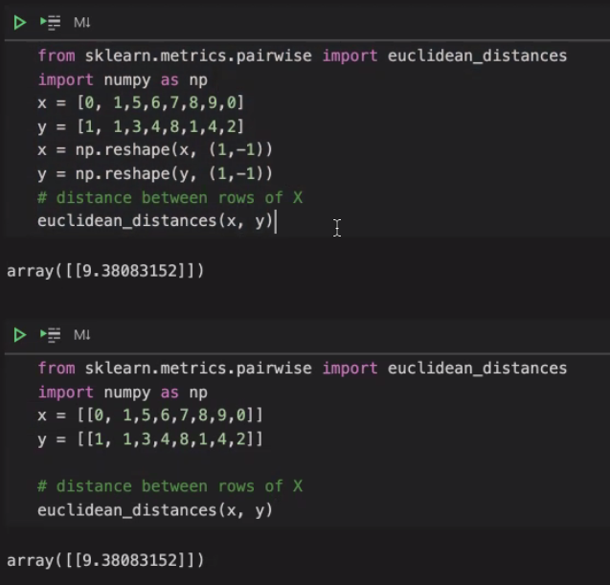

Slide 21
Break till 8.30 pm

